Slide 1
Using Voorn-2013 or Rotary dataset
Omar Alamoudi

Slide 2
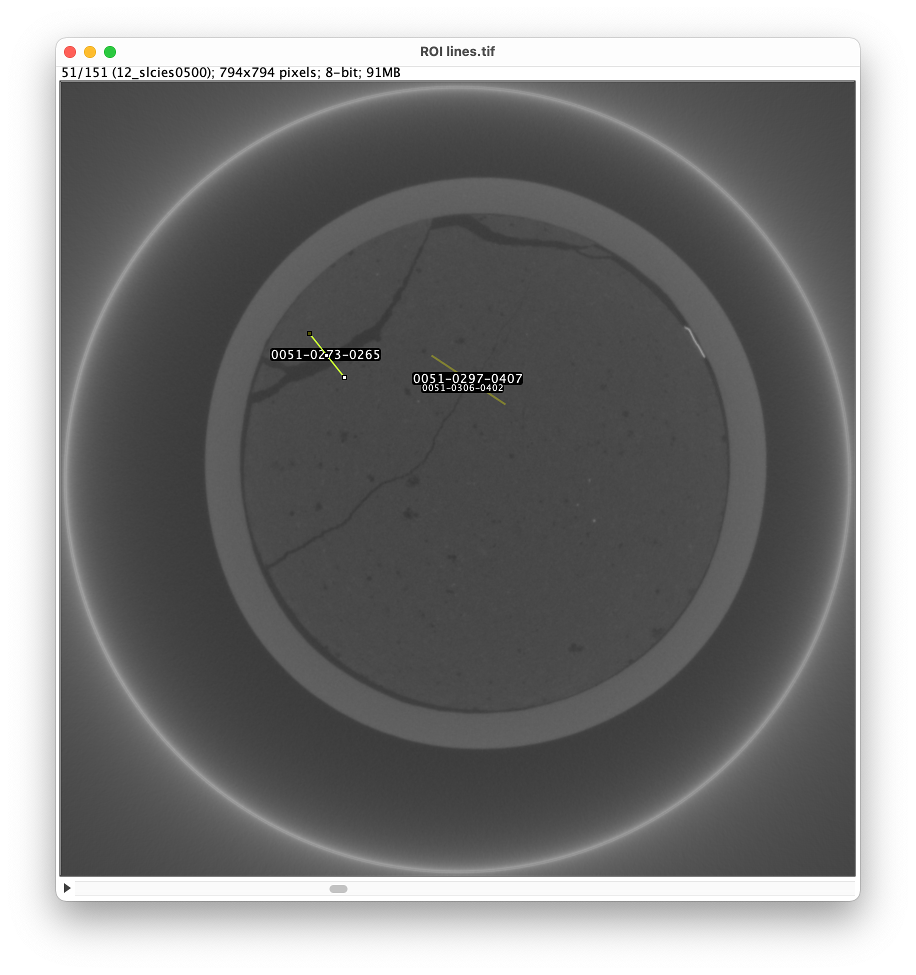
Determining the min and max values of s
150 slices (450-600)
Slice 51 (image name 500) is shown
Range of fracture sizes

Slide 3
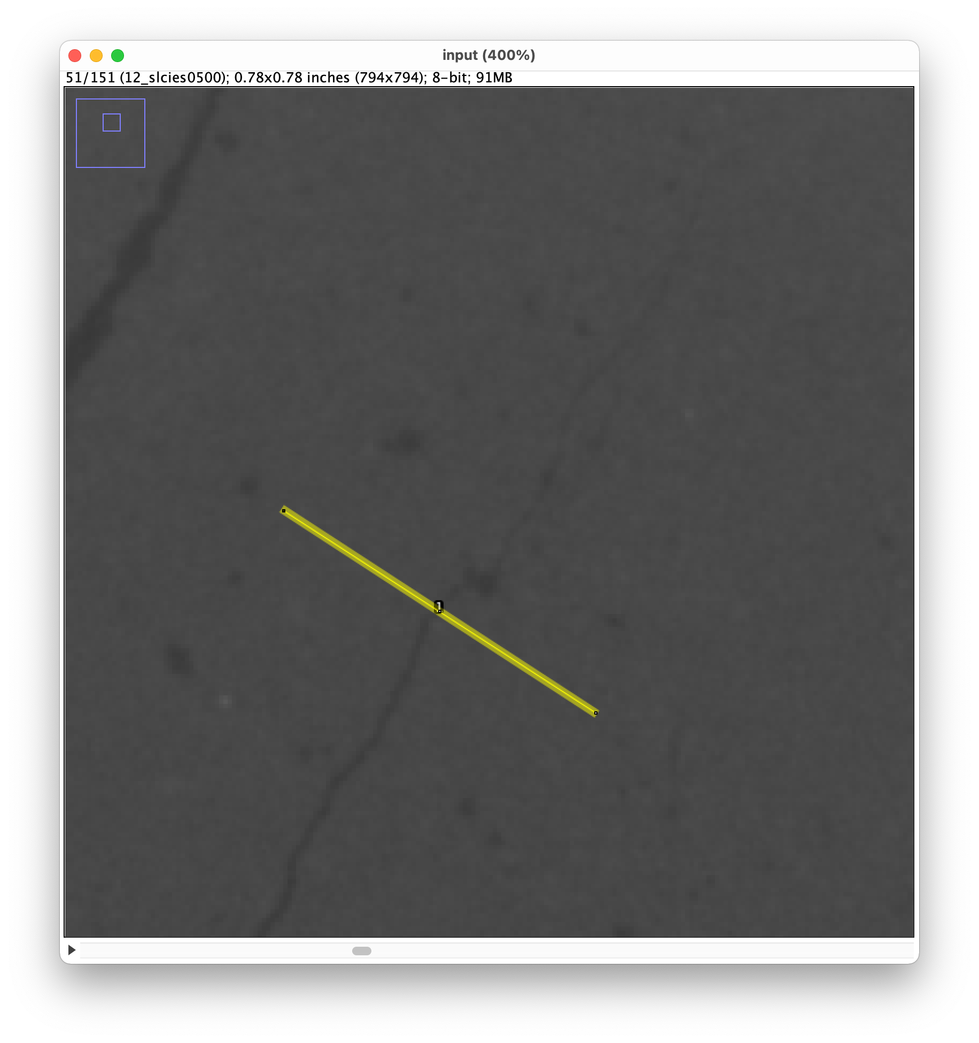
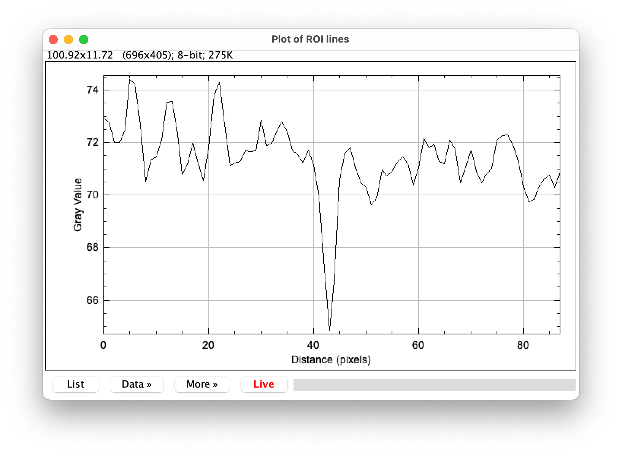
Determining the min and max values of s
Fracture

Slide 4
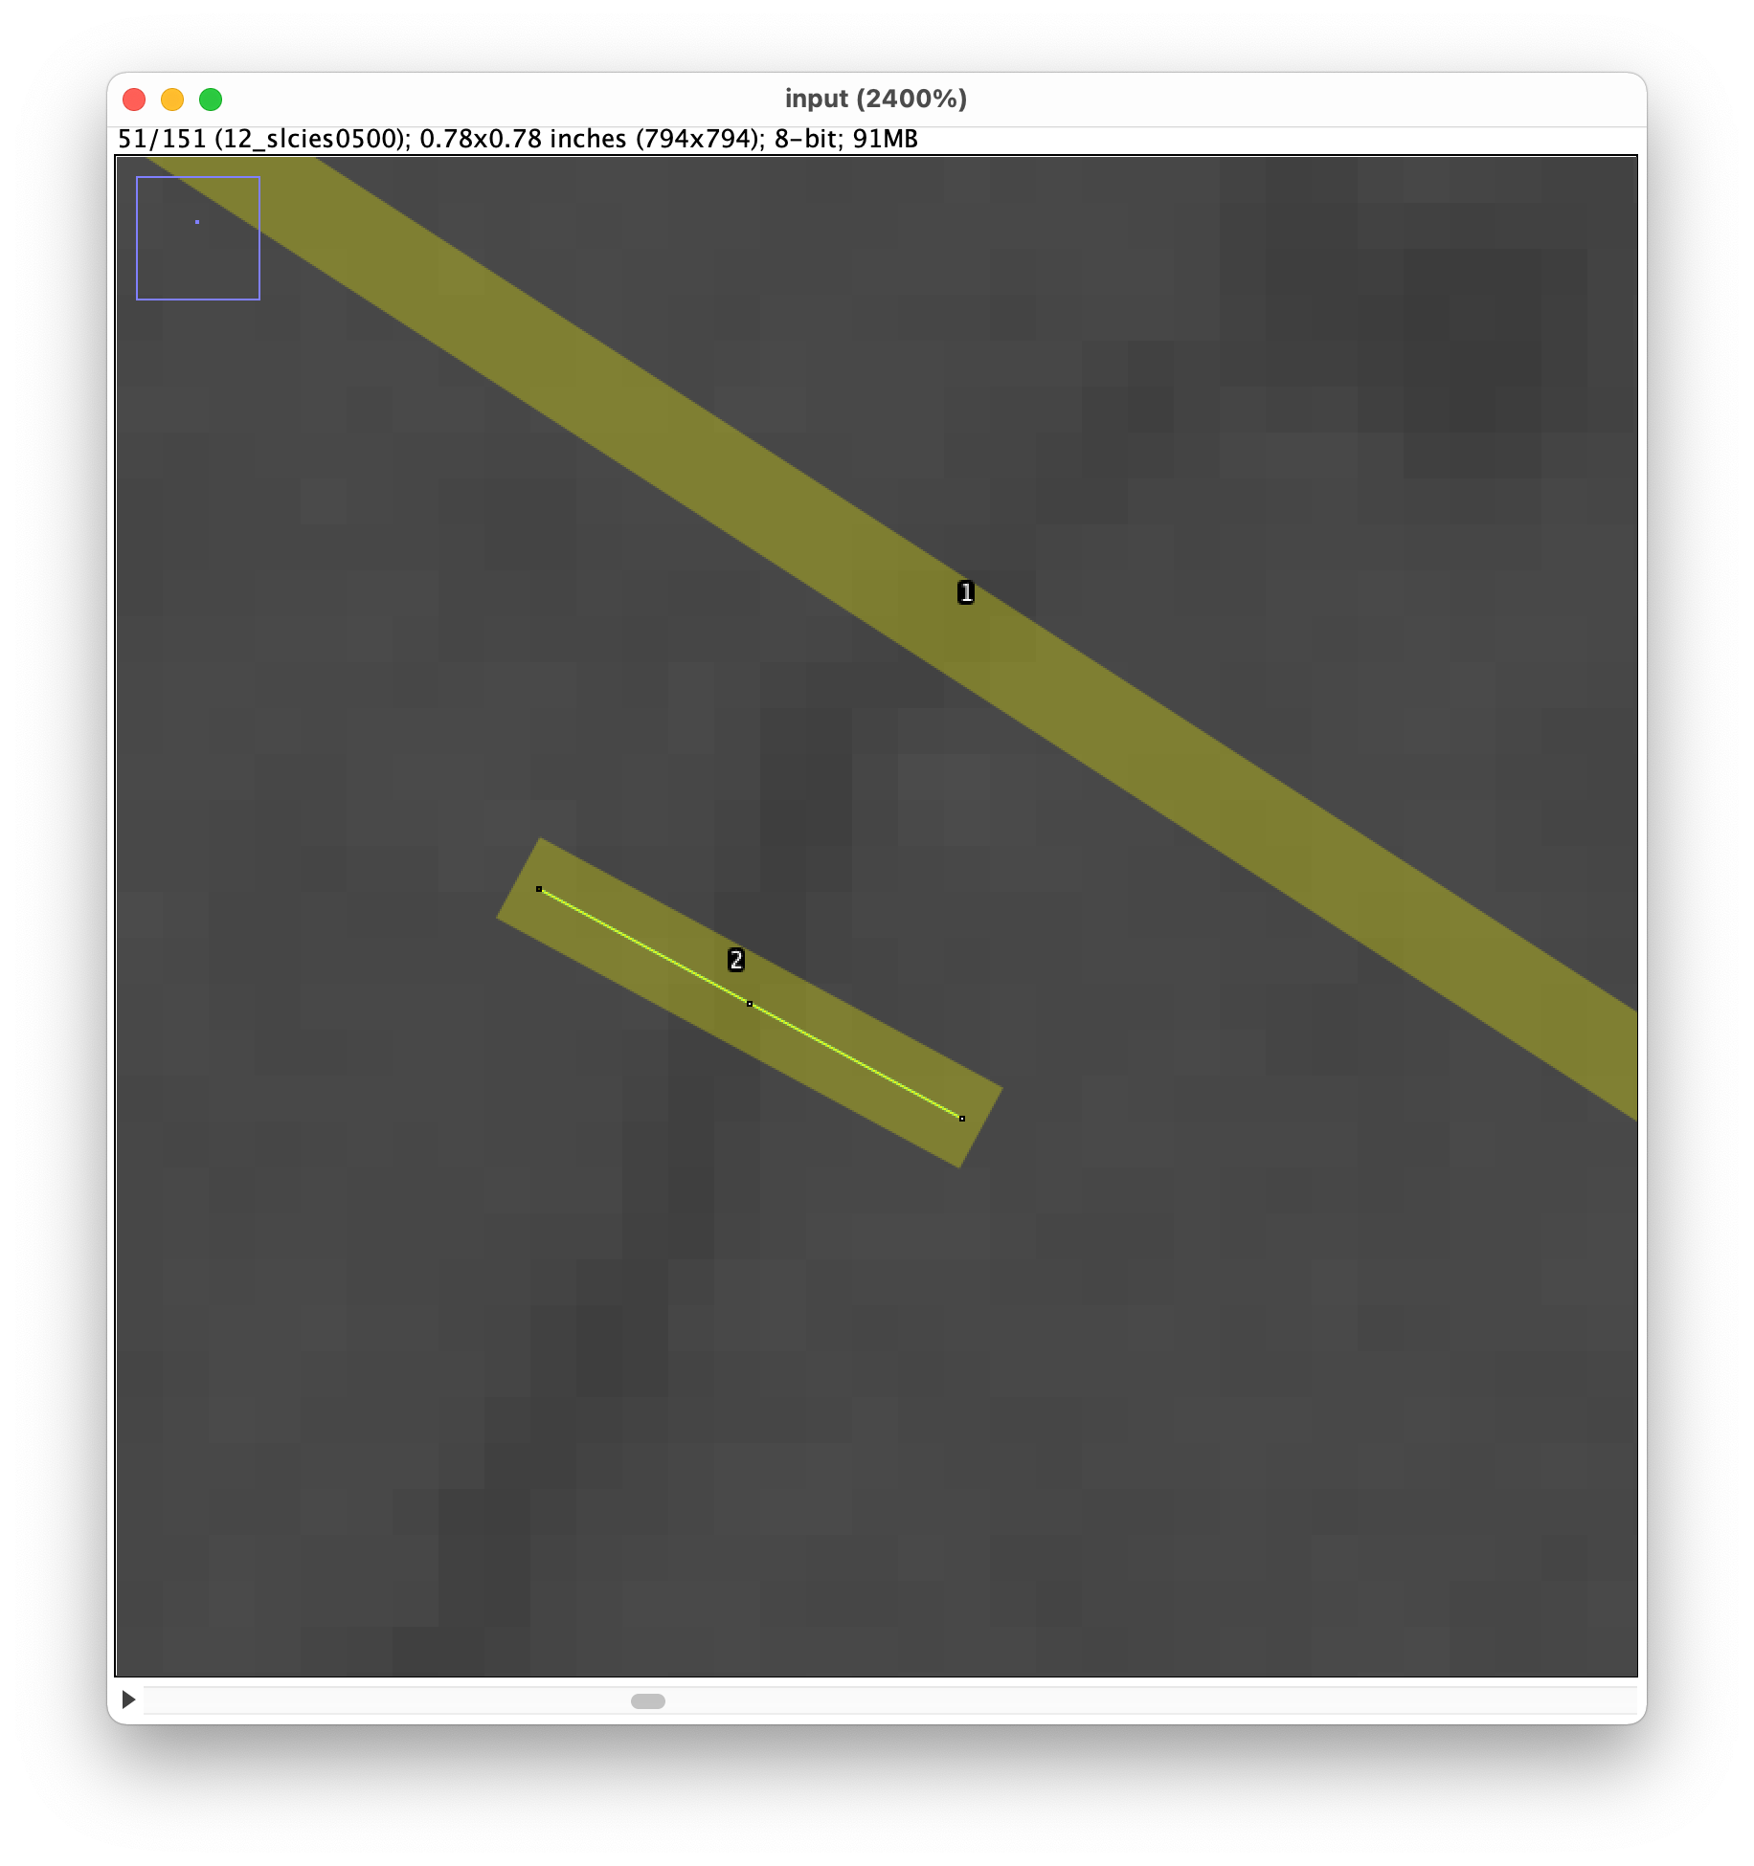
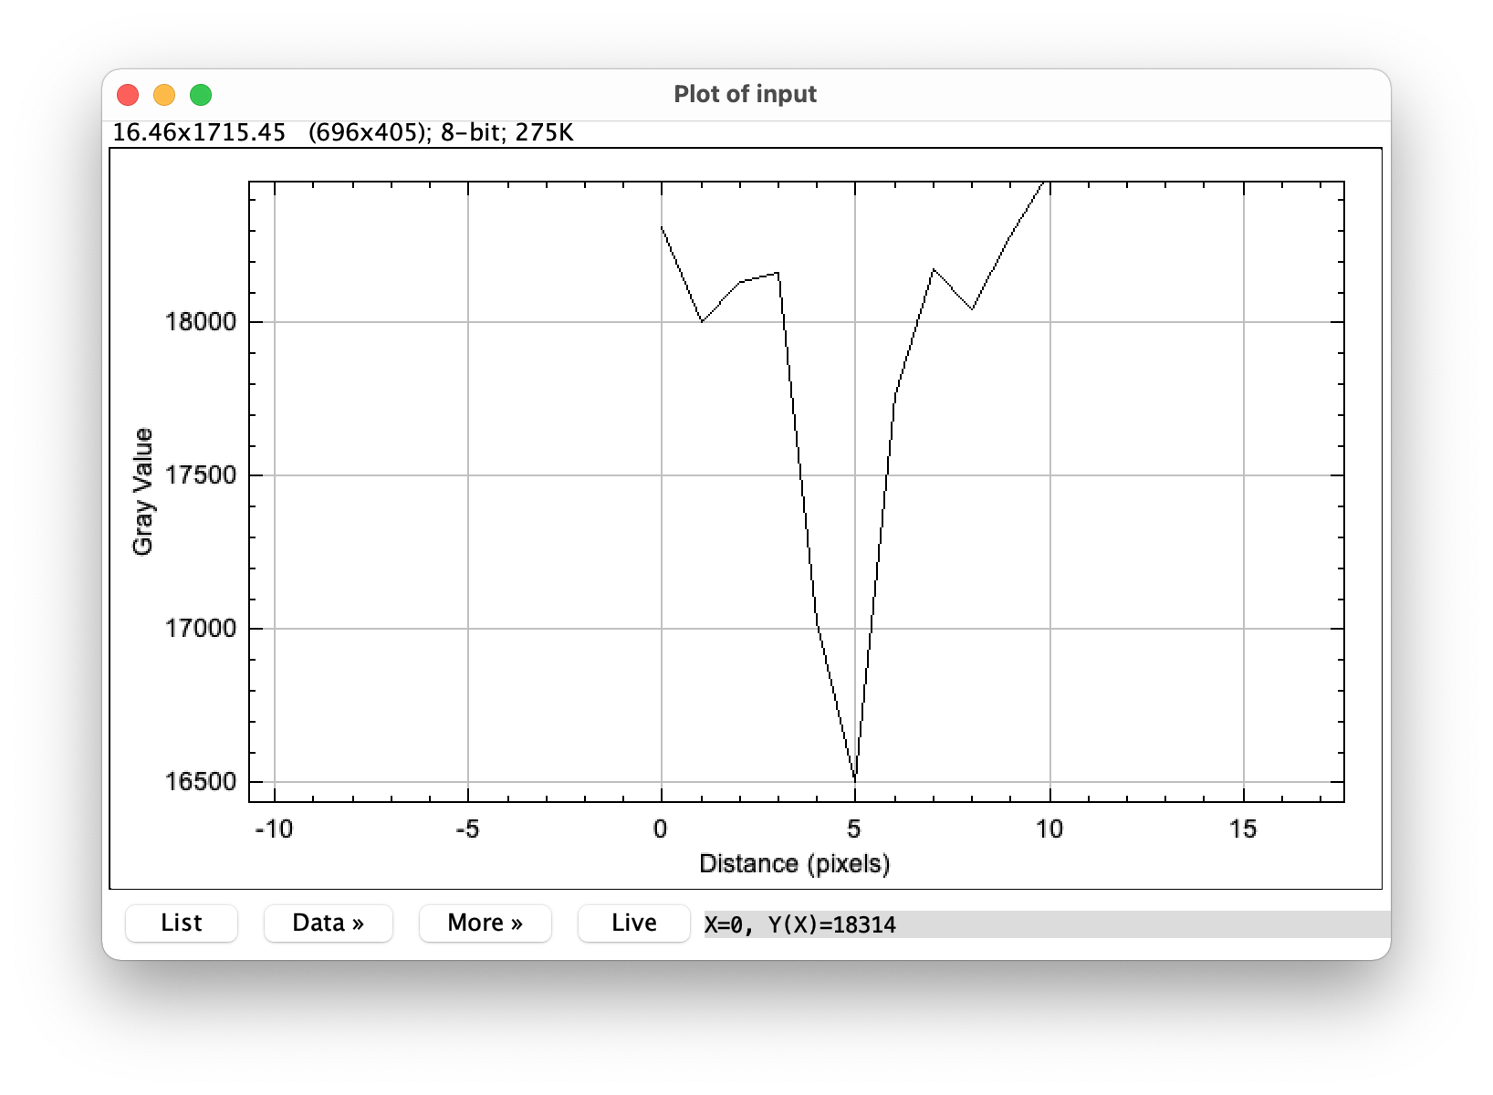
Determining the min and max values of s
s_min = 1
s_max =
S_min
Fracture

Slide 5
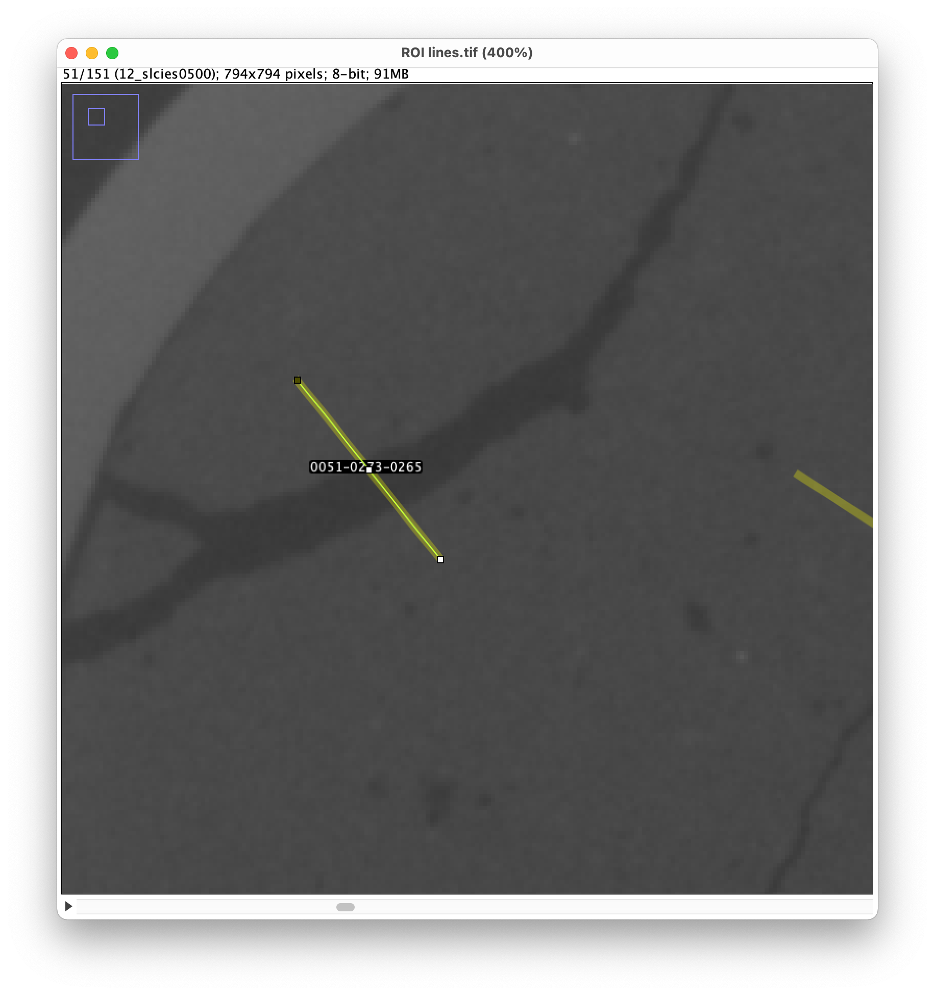
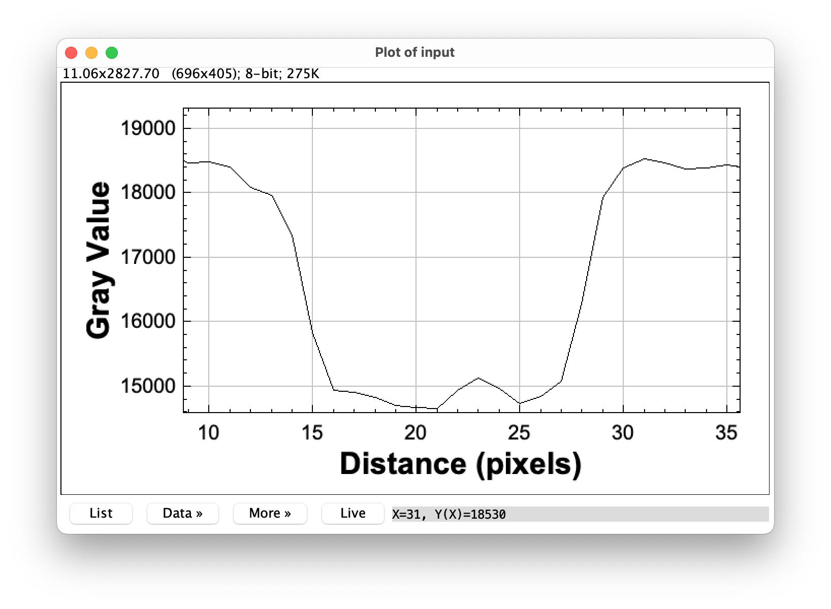
Determining the min and max values of s
s_min = 1
s_max = 7
S_step = 2
S_max
Fracture

Slide 6
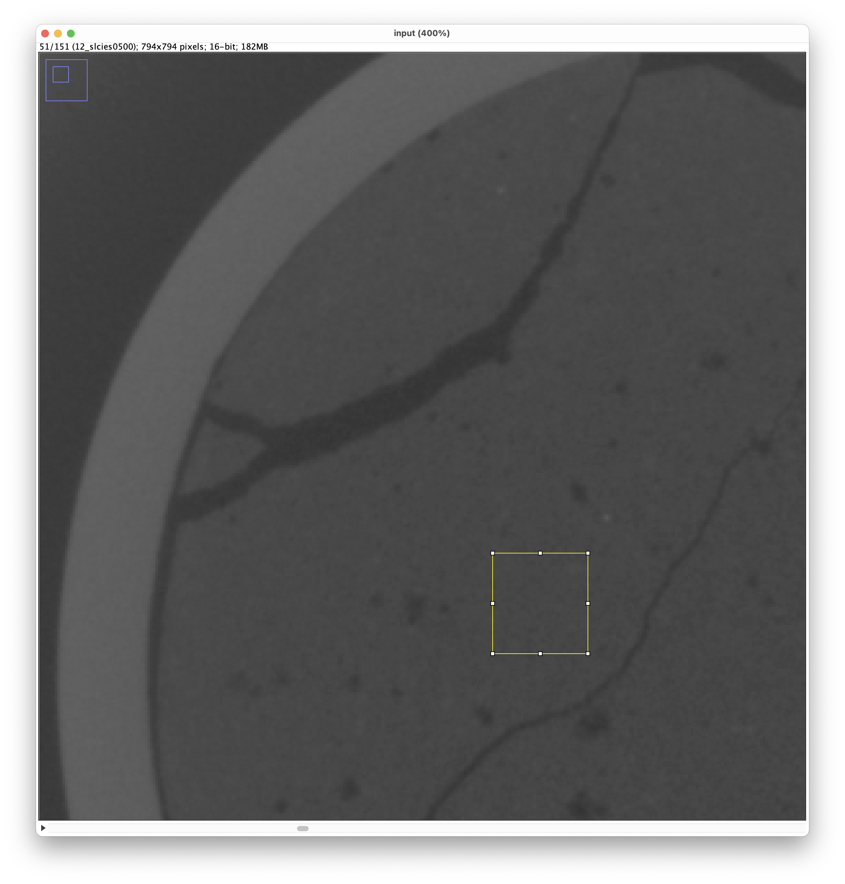
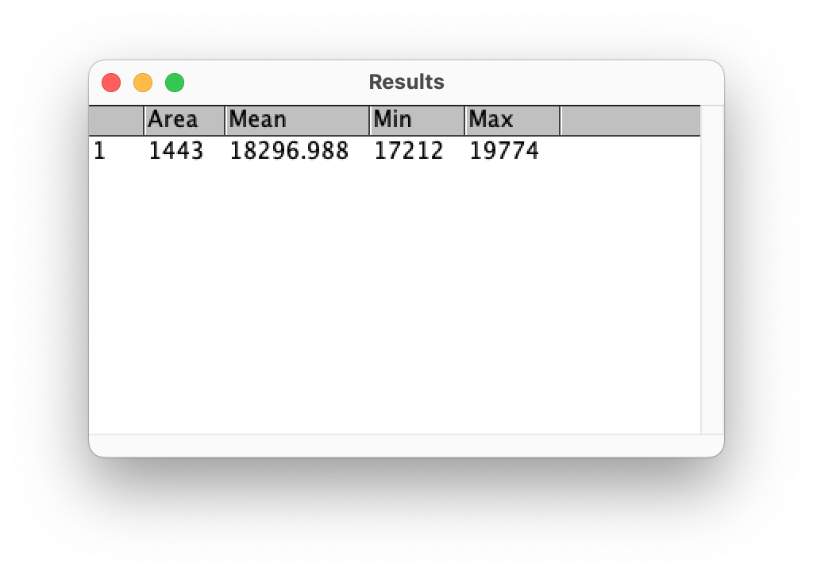
Parameter: avgmat

Slide 7
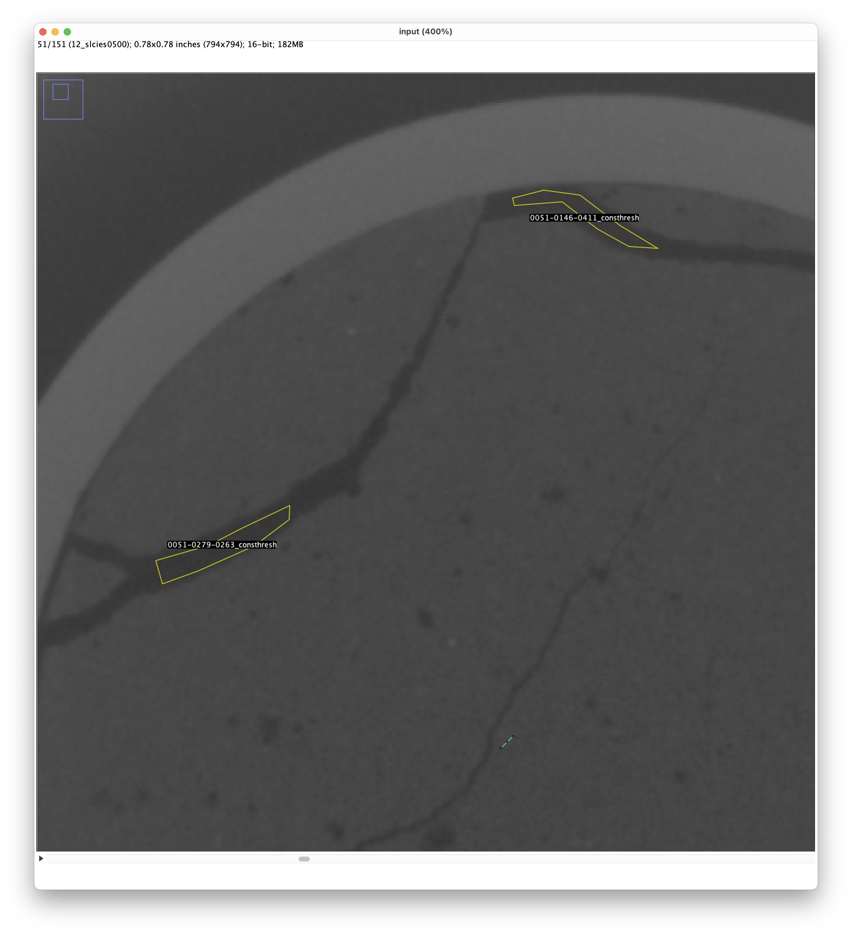
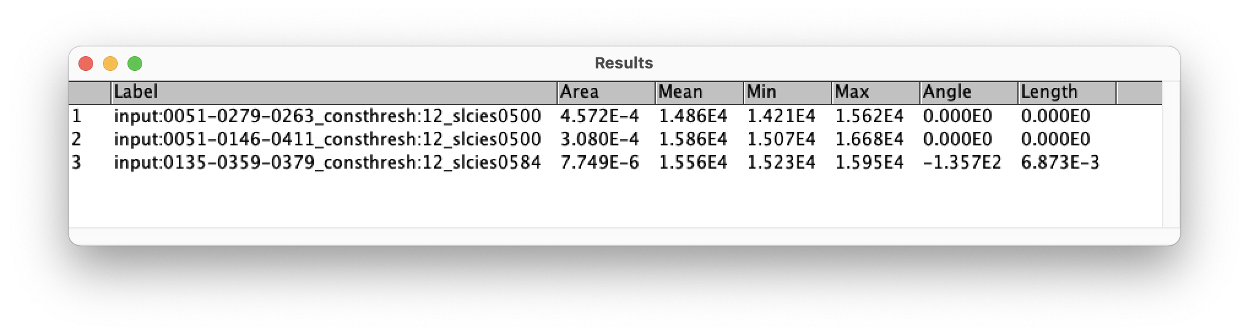
Parameter: consthresh

Slide 8
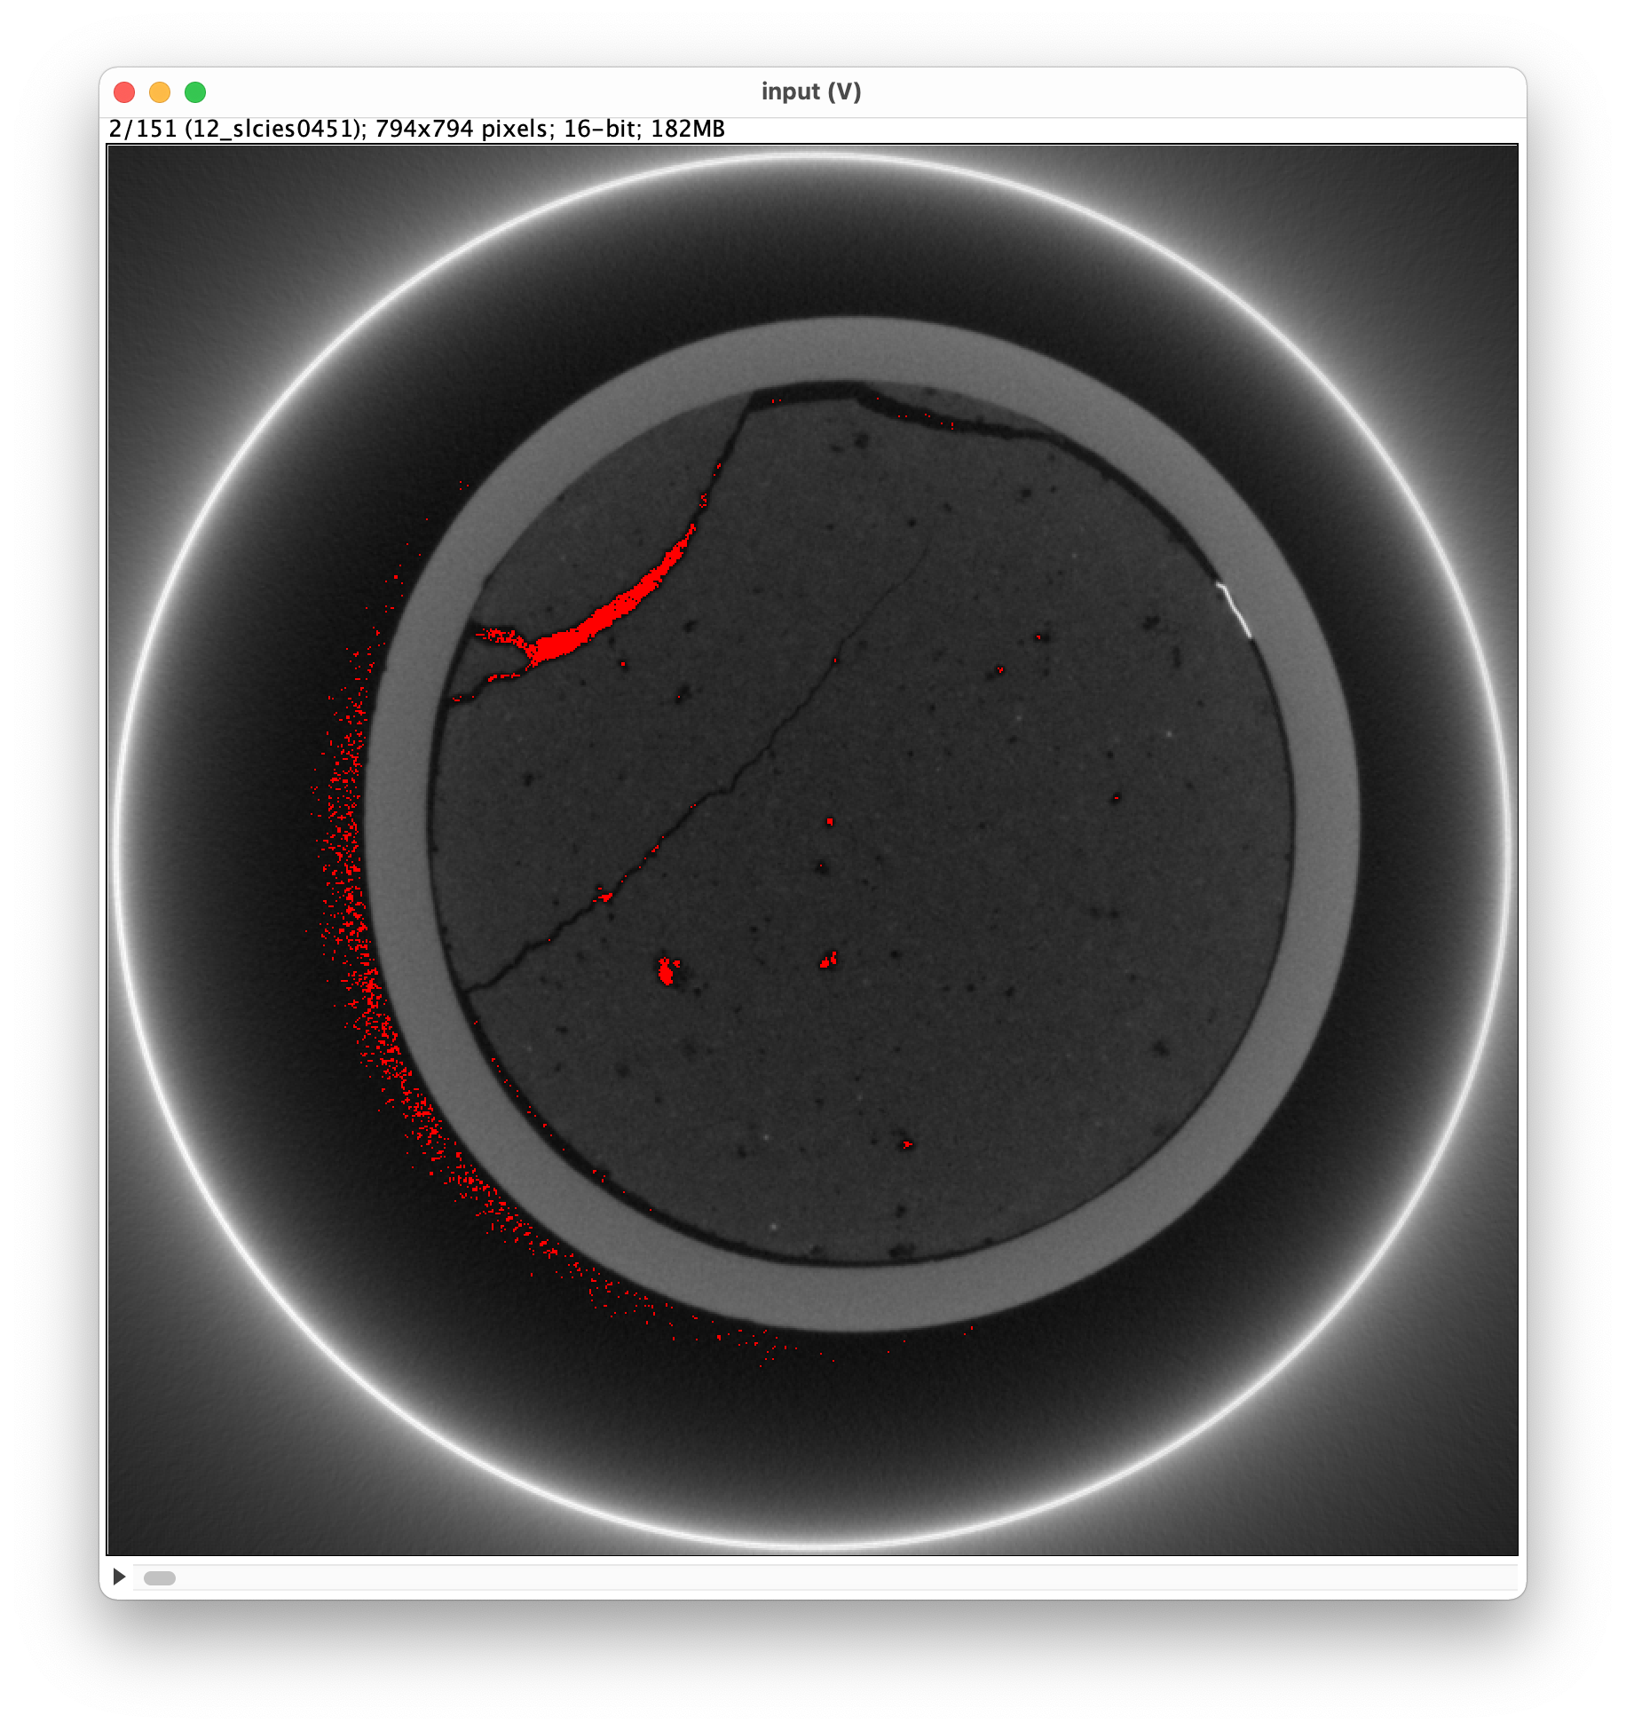
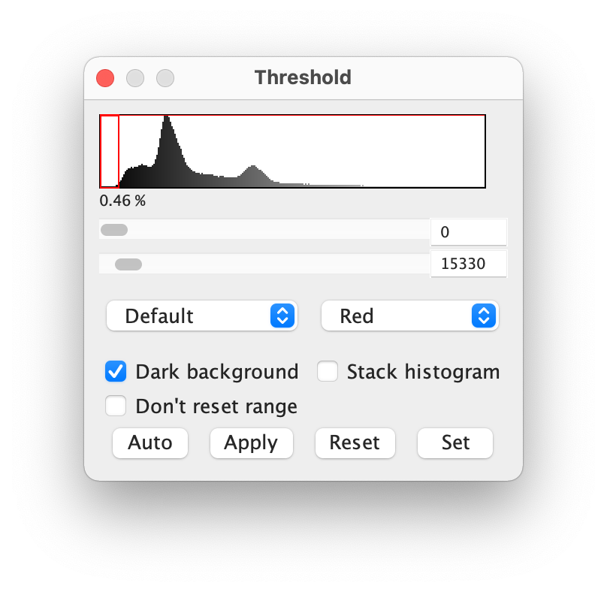
Consthresh = 15330

Slide 9
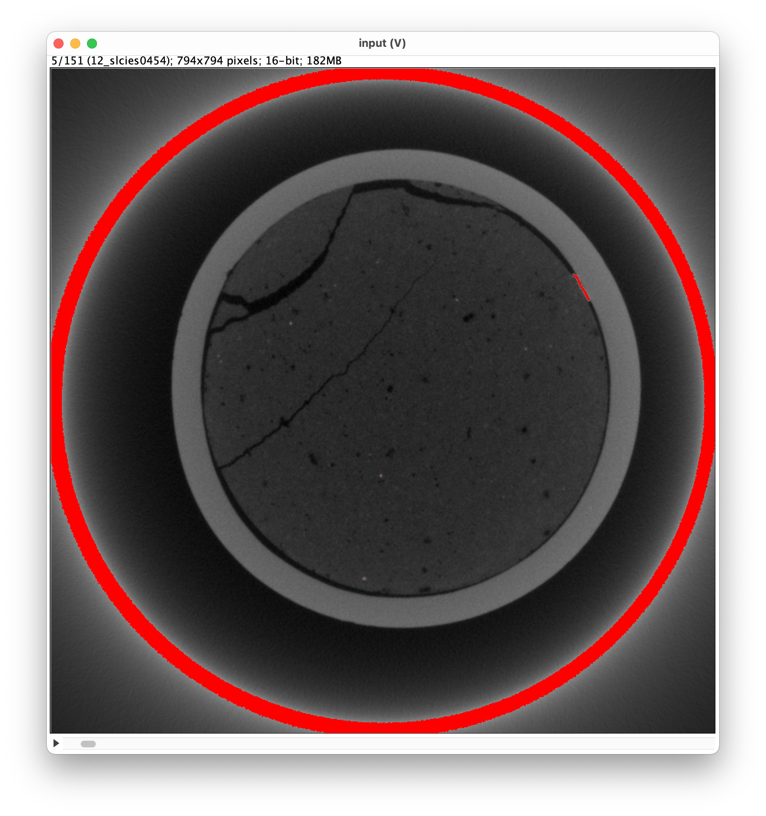
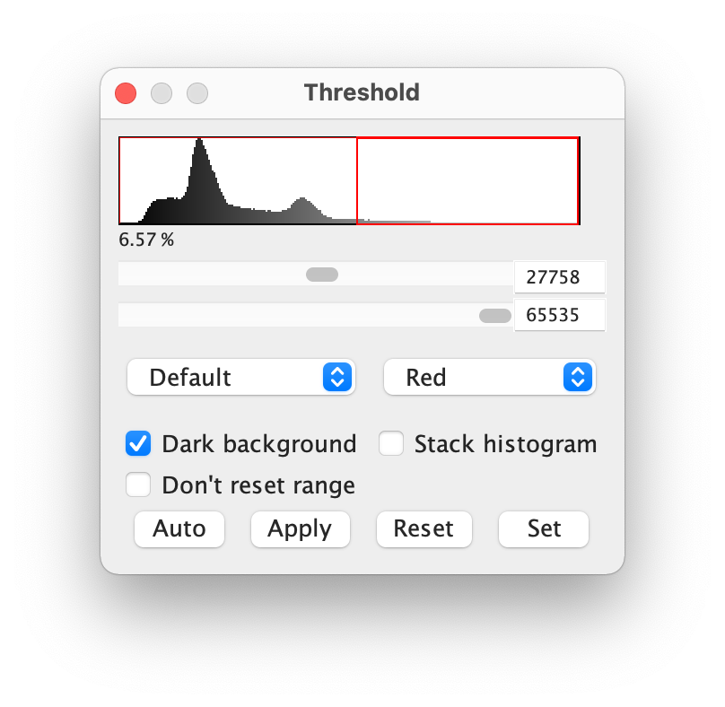
Maxmat = 27760

Slide 10
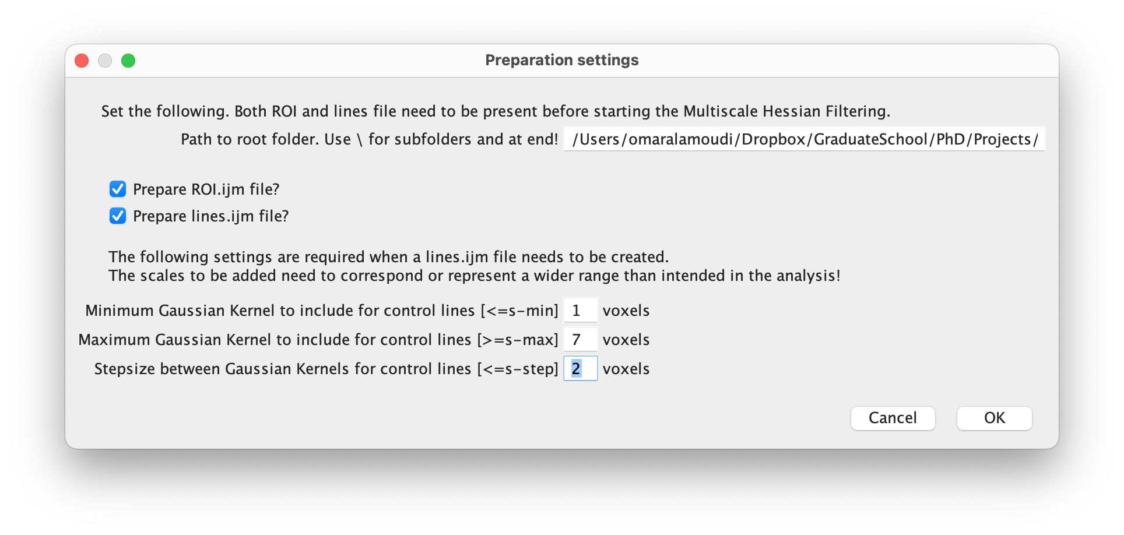
MSHFF_Prep.ijm

Slide 11
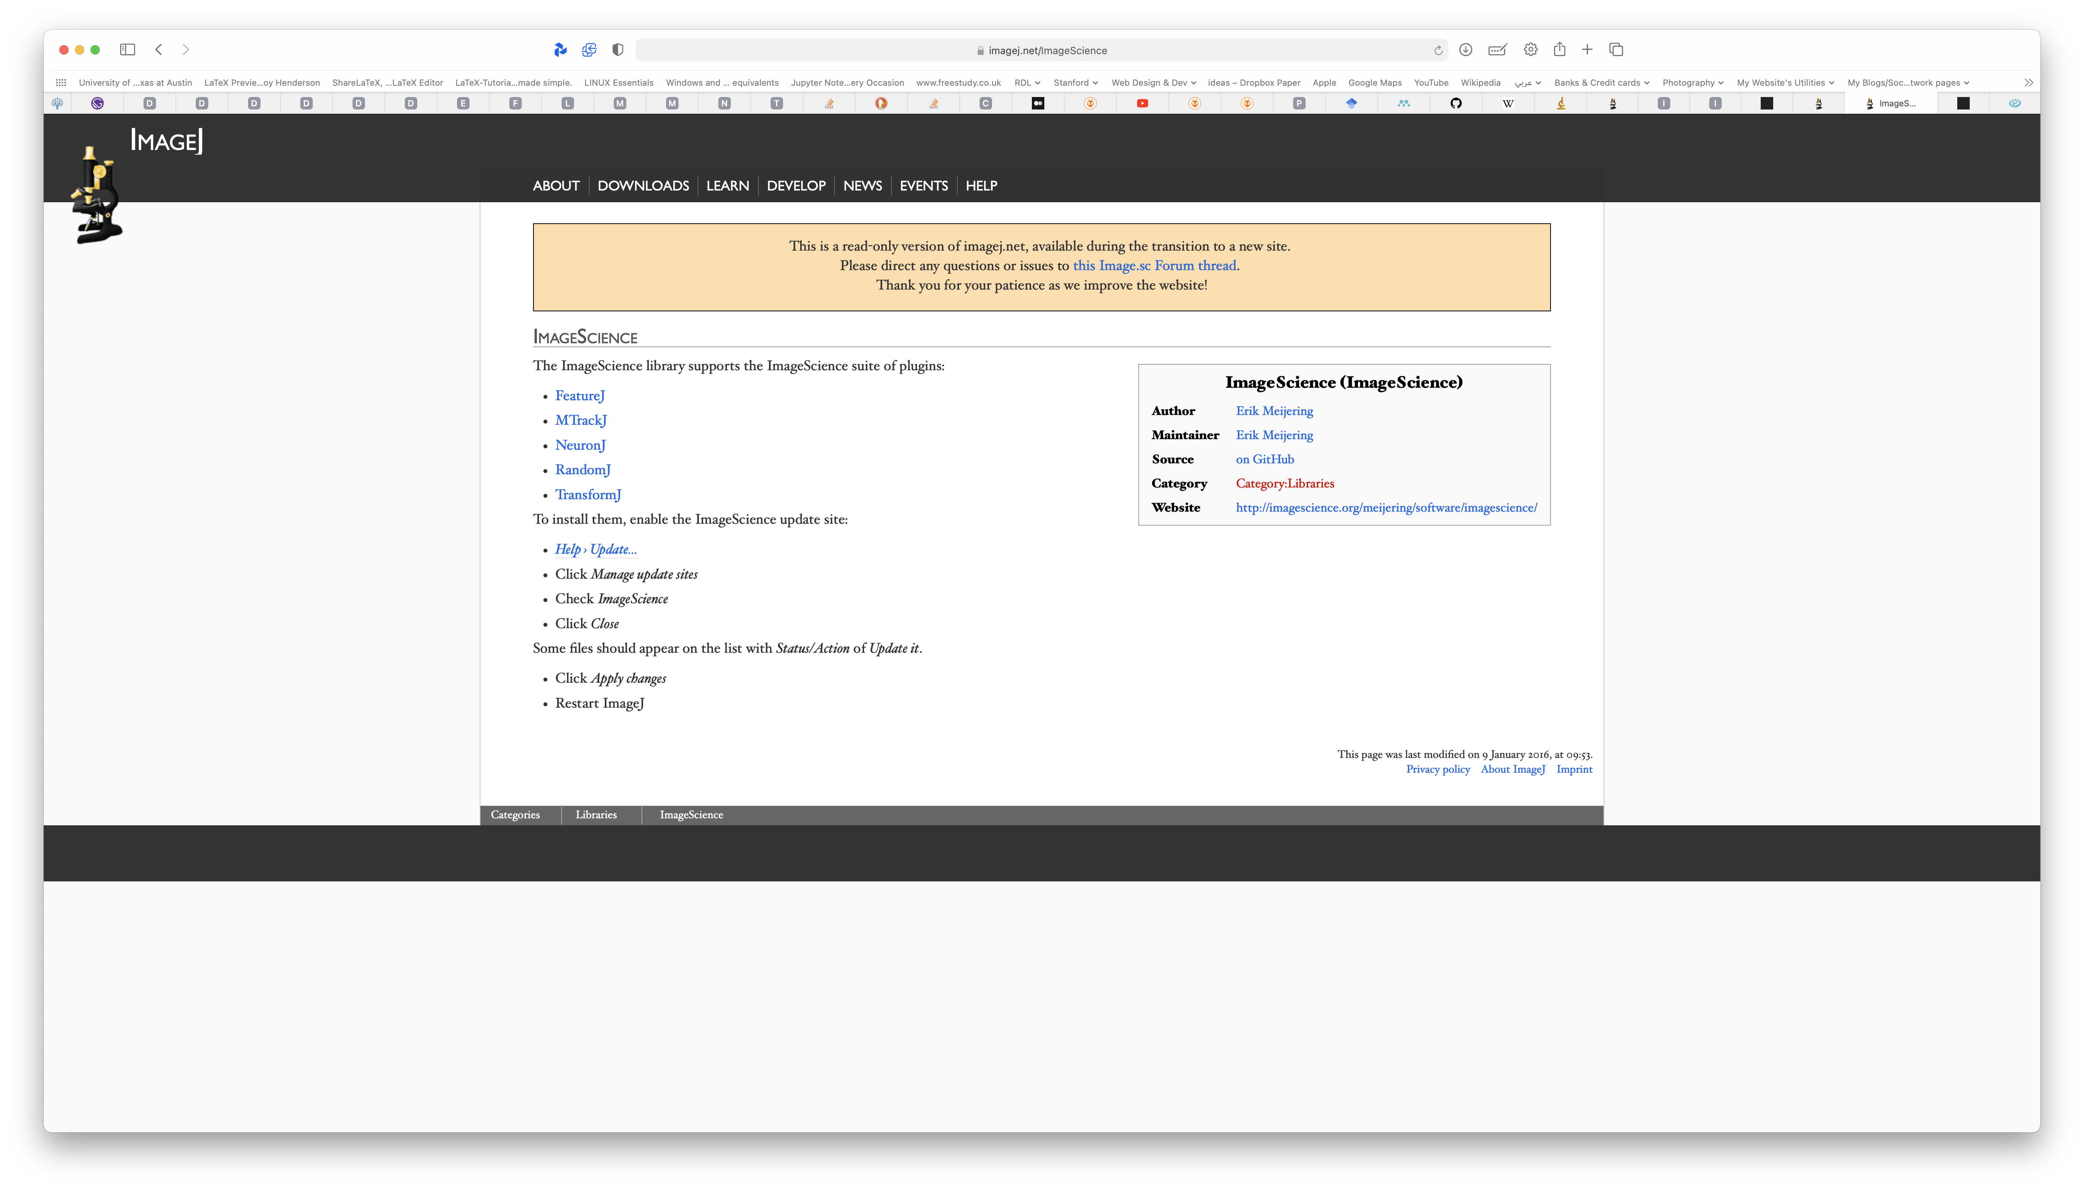
Before running MSHFF
Download FeatureJ
https://imagej.net/ImageScience
Also see: https://imagescience.org/meijering/software/featurej/

Slide 12
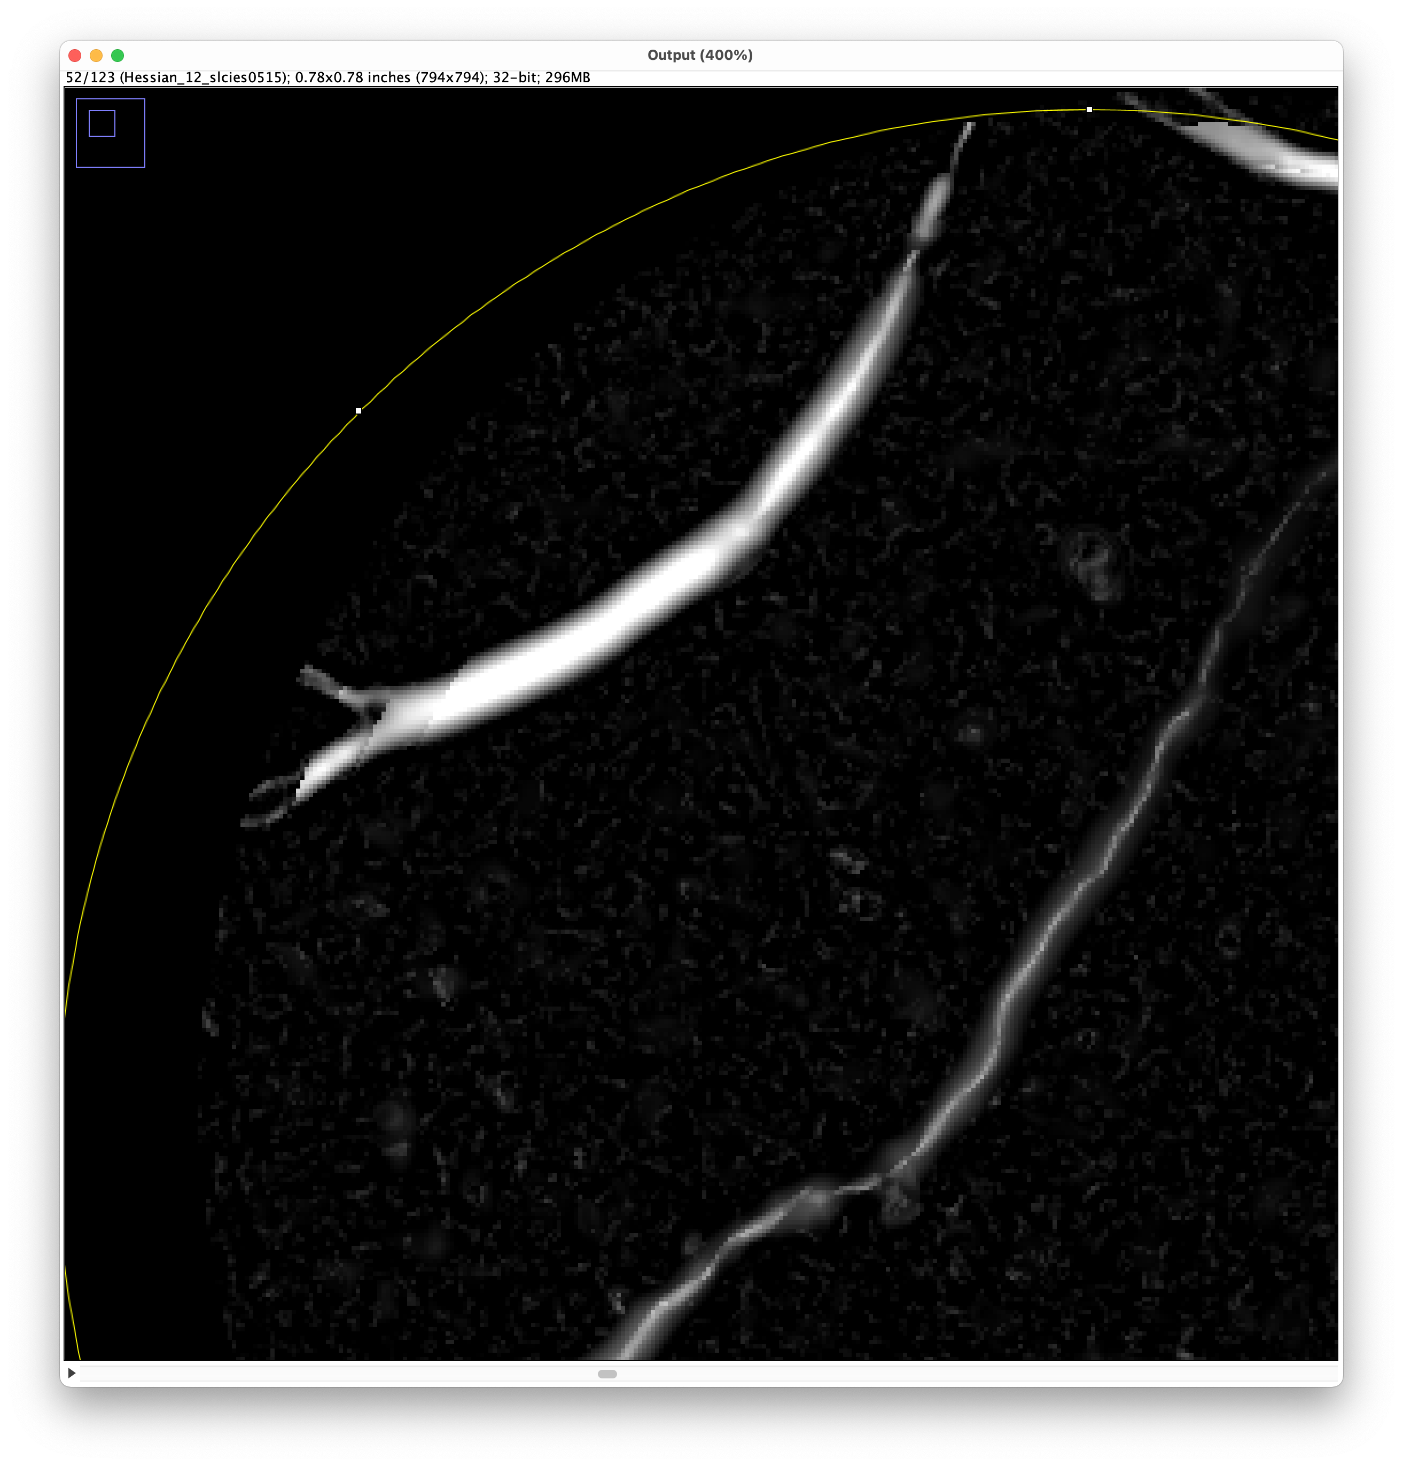
Result

Slide 13
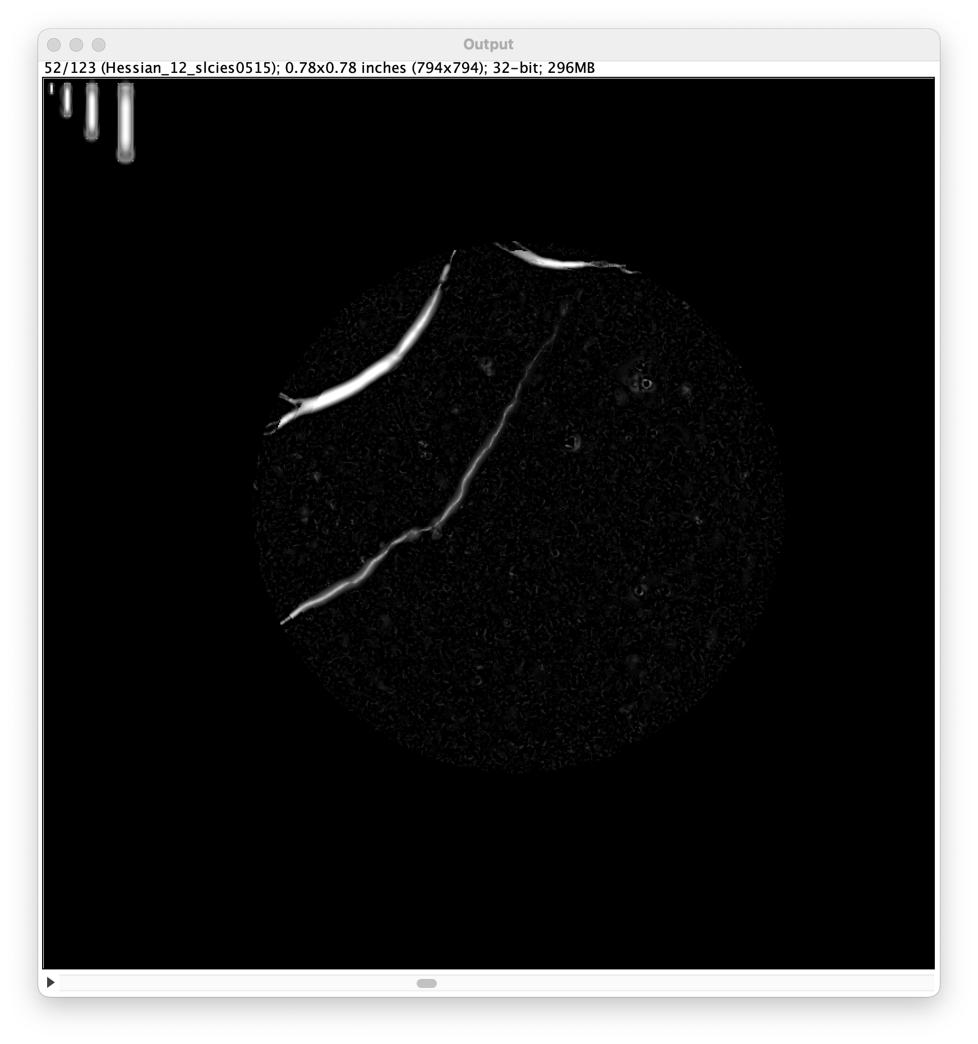
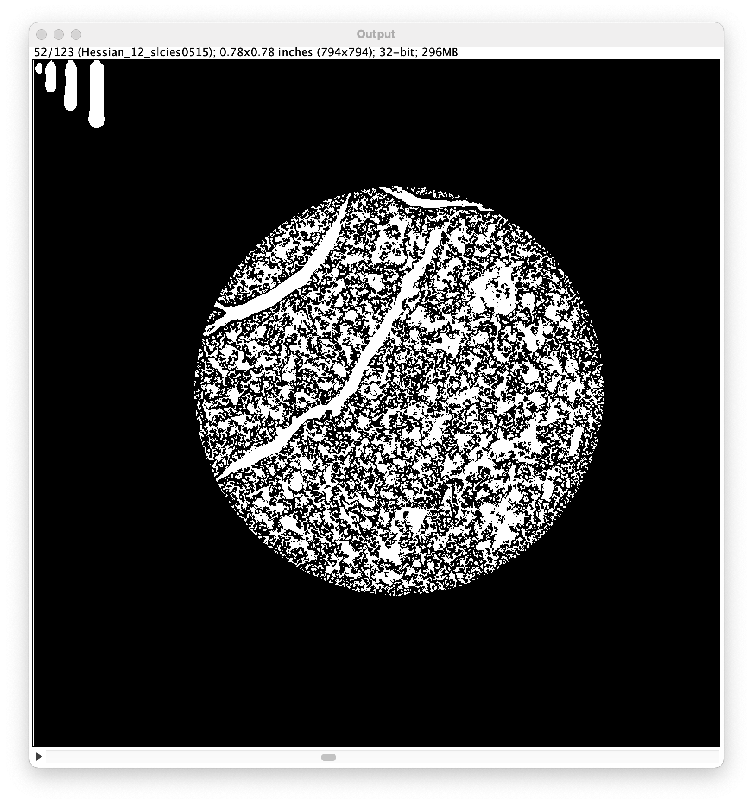
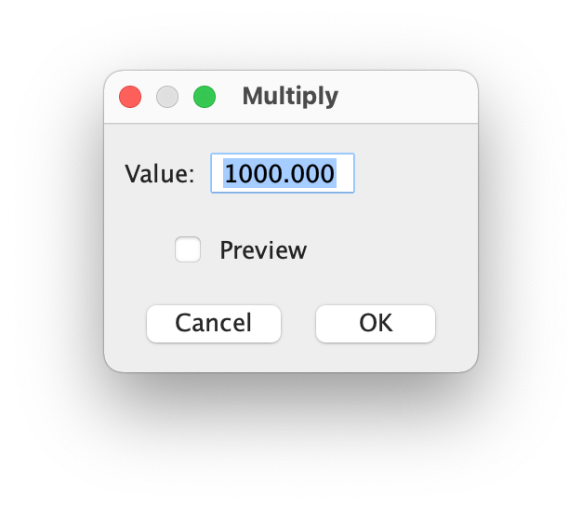
Calibration
+
=

Slide 14
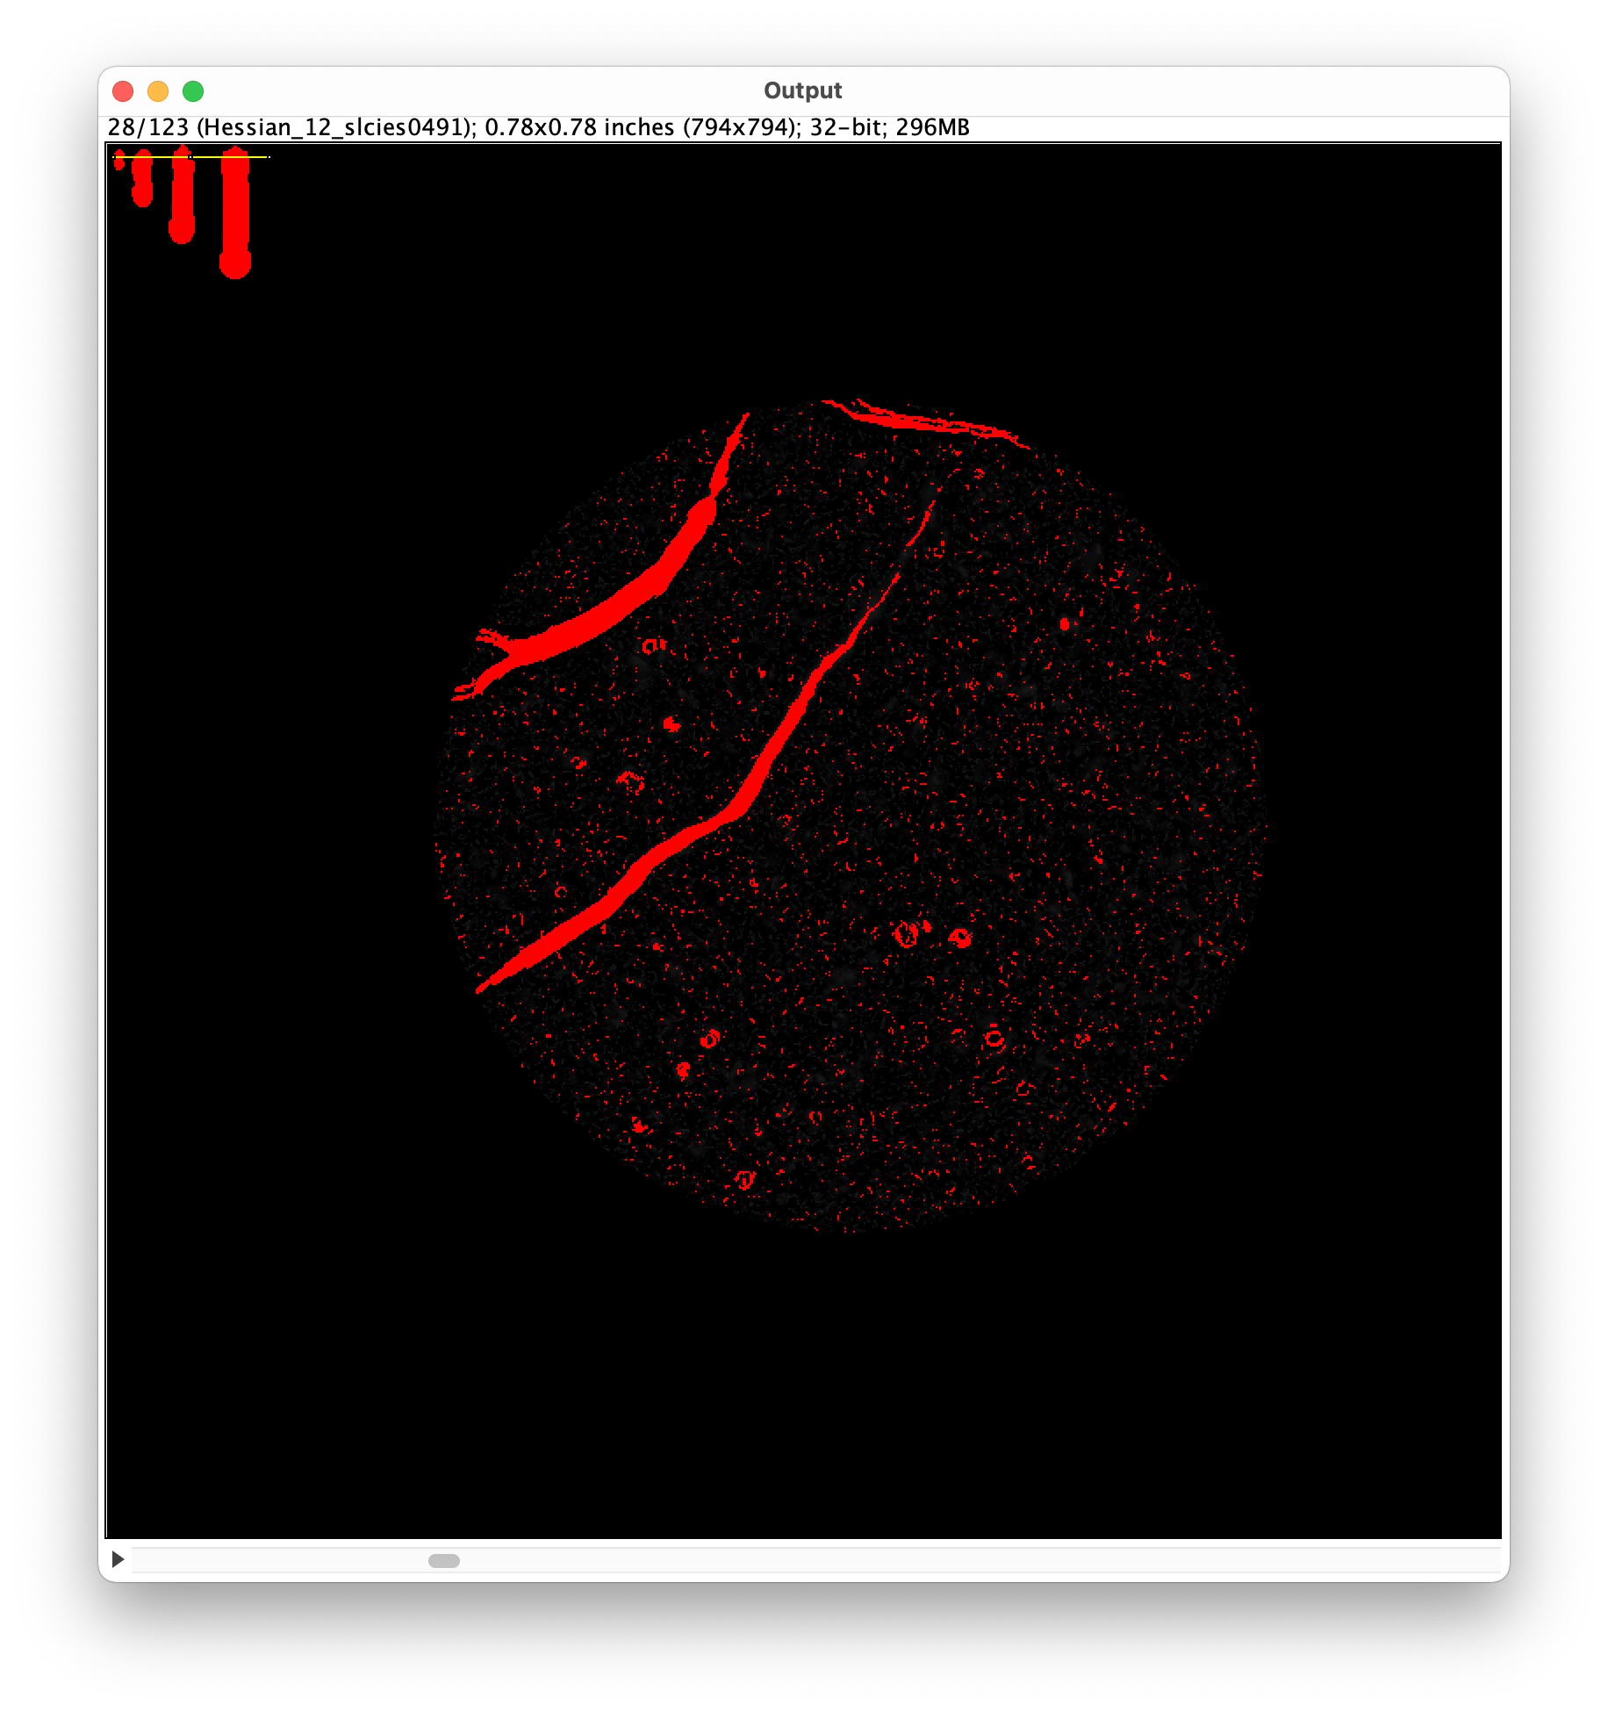
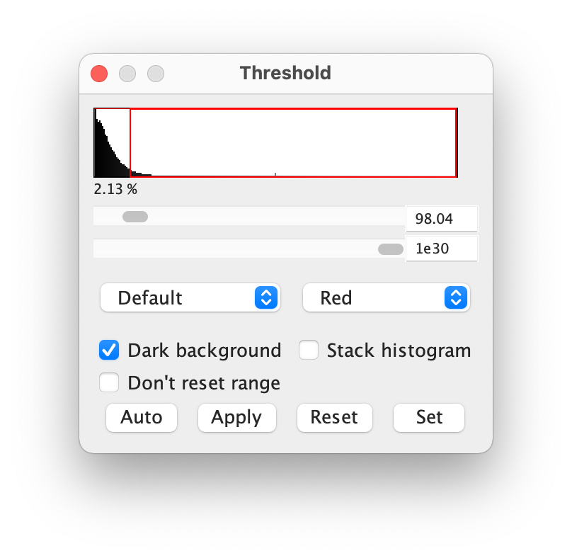
Calibration: mincal = 98
+
=

Slide 15
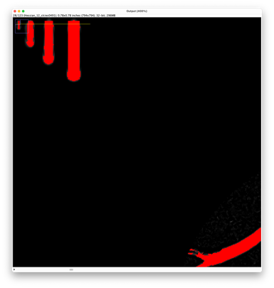
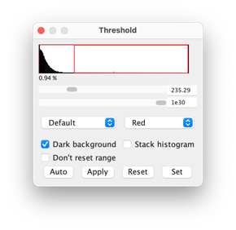
Calibration: maxcal = 235
+
=

